Slide 1



Workshop Day 2: SIMROUTE: Dangerous situations in adverse weather and sea conditions
Further Modules
Chalmers University of Technology
April 6th, 2022

Slide 2
The Maritime Safety Committee (MSC), approved the Revised Guidance (2007) to the master for avoiding dangerous in adverse weather and sea conditions, with a view to providing masters with a basis for decision making on ship handling in adverse weather and sea conditions, thus assisting them to avoid dangerous phenomena that they may encounter in such circumstances.

Slide 3
Some combinations of wave length and wave height under certain operation conditions may lead to dangerous situations for ships complying with the Intact Stability Code (IS Code).
When sailing in adverse weather conditions, a ship is likely to encounter various kinds of dangerous phenomena, which may lead to capsizing or severe roll motions causing damage to cargo, equipment and persons on board.

Slide 4
The sensitivity of a ship to dangerous phenomena will depend on the actual stability parameters, hull geometry, ship size and ship speed.
This implies that the vulnerability to dangerous responses, including capsizing, and its probability of occurrence in a particular sea state may differ for each ship.

Slide 5
When a ship is sailing in adverse weather and sea conditions, following dangerous phenomena may be encountered:
1. Surf-riding and broaching-to
2. Parametric rolling motion
3. Slamming
4. Green water

Slide 6
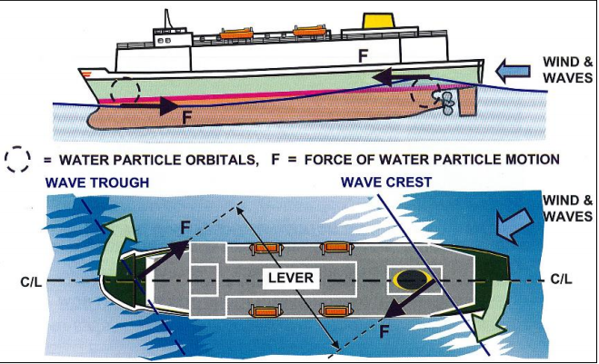
Surf-riding and Broaching-to
The risk of broaching in heavy following seas.
Source: Clark (2005) Ship Dynamic for Mariners. London, The Nautical Institute.

Slide 7


Surf-riding and broaching-to
Surf-riding may occur when both of this conditions are fulfilled:
And
$$V_{ship}>\frac{1.8\sqrt{L_{ship}}}{cos⁡(180−α)}$$
$$135º<α<225º$$

Slide 8
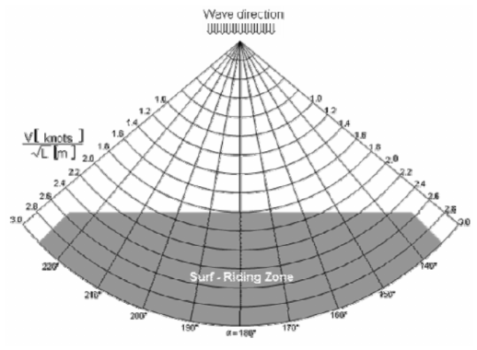
Surf-riding and broaching-to
To avoid surf riding (and possible broaching) the ship speed, the course or both should be taken outside the dangerous region reported in following figure (IMO, MSC.1/Circ.1228, 2007):

Slide 9
Surf-riding and broaching-to
In regards of this formula, the necessary parameters are the following ones:
Angle of encounter (𝜶): being the ship-to-wave relative direction (𝛼=180° for following seas). In other words, the wave direction angle minus the vessel course.
Length of the ship (L_{ship}): the distance between the perpendiculars, in meters
Speed of the ship (v_{ship}): The speed selected for this study is the one which corresponds to the full sea ahead engine order, in knots

Slide 10
Parametric roll motion
Parametric roll motions with large and dangerous roll amplitudes in waves are due to the variation of stability between the position on the wave crest and the position in the wave trough.
Parametric rolling is produced by pitching motions on vessels that have very fine bowlines together with very wide and full stern contours. One such ship type is the container ship and barges.

Slide 11
Parametric roll motion
As the stern dips into the waves it produces a rolling action. This remains unchecked as the bow next dips into the waves due to pitching forces.
In effect, the rolling characteristics are different at the stern to those at the bow.
This causes a twisting or torsioning along the ship, leading to extra rolling motions.

Slide 12
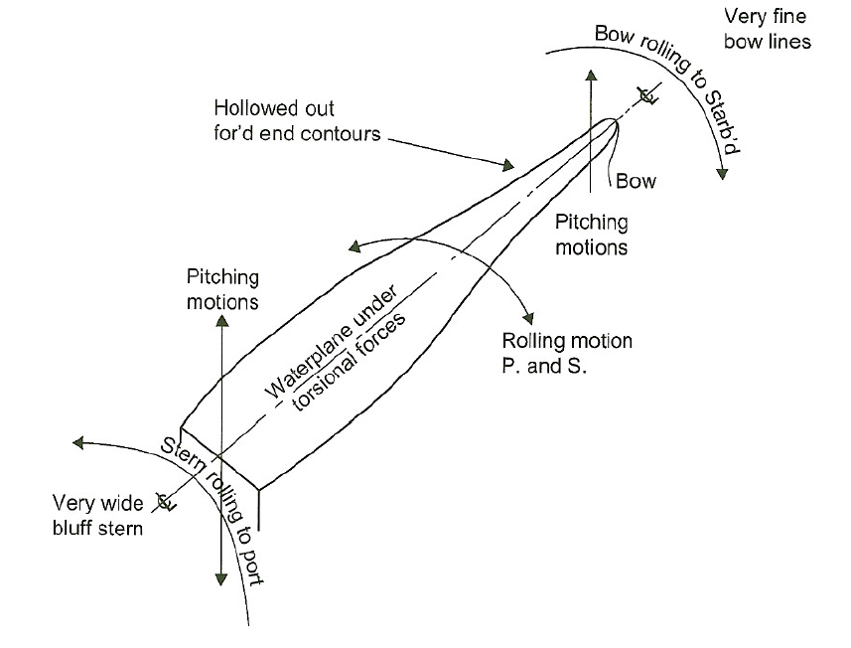
Parametric roll motion

Slide 13
Parametric roll motion
Parametric rolling is worse when a ship is operating at reduced speed in heavy sea conditions.
Such condition can cause containers to be lost overboard due to broken deck lashings.

Slide 14
Parametric roll motion
To reduce the parametric roll motion:
A water ballast could be used to alter the GMt, and hence the natural rolling period to a nonsynchronous value.
The ship needs to have an anti-rolling acting stabilizing system. A quick response time is vital to counteract this type of rolling.
Alter the ship’s forward speed.
Alter the ship’s course.

Slide 15

Parametric rolling
May occur when one of these following conditions are fulfilled:
$\left|T_{E}−T_{R}\right|=ε·$ $T_{R}$
$\left|2·T_{E}−T_{R}\right|=ε·$ $T_{R}$
Being $ε$ the tolerance, $T_{E}$ the encountered period and $T_{R}$ the natural roll period.

Slide 16
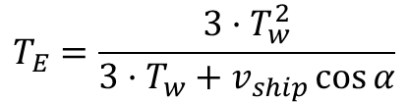
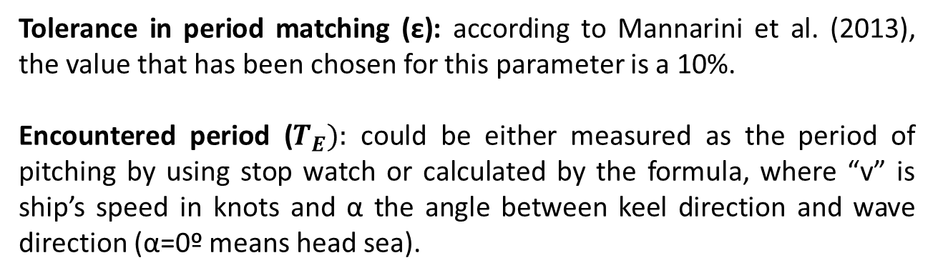
Parametric rolling
Tolerance in period matching (ε): according to Mannarini et al. (2013), the value that has been chosen for this parameter is a 10%.
Encountered period ($T_{E}):$ could be either measured as the period of pitching by using stop watch or calculated by the formula, where “v” is ship’s speed in knots and α the angle between keel direction and wave direction (α=0º means head sea).
$$T_{E}=\frac{3·T_{w}^{2}}{3·T_{w}+v_{ship}\cos{α}}$$
T_{w}: Peak wave period

Slide 17

Parametric rolling
T_{R}: Natural roll period. it measures the period of rolling motions preferably when the ship is in calm sea. This period is obtained through:
$$T_{R}=\frac{2·C·B}{\sqrt{{GM}_{T}}}$$

Slide 18


Parametric rolling
C: coefficient
B: Beam of the ship
d: draft of the ship
${GM}_{T}:$metacentric height of the ship
C=0.373 + 0.023·$\left(\frac{B}{d}\right)−0.043·\left(\frac{L_{ship}}{100}\right)$

Slide 19
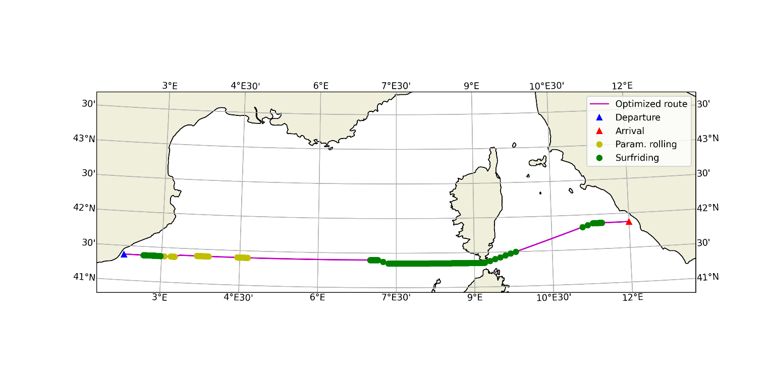
SIMROUTE Surf-riding & Parametric rolling

Slide 20
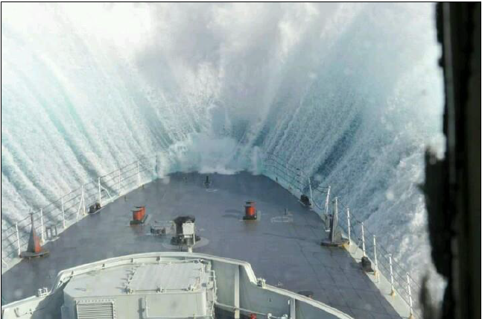
Slamming

Slide 21
Slamming
Slamming is a singular undesirable phenomenon that is most likely to occur when a vessel is pitching to head waves, and these ones are a little bit longer than the vessel’s lengths.
In the case of pitch and heave combination, the bottom’s front part of a vessel can be considerably elevated from the sea surface and a slam take place when the vessel restores its position.

Slide 22
Slamming
It will affect to the structure of the ship due to a heavy dynamic impact that will be produced in the bottom of the ship.
Slamming can produce personal damages, breaks, failures of important operational equipment, etc.

Slide 23
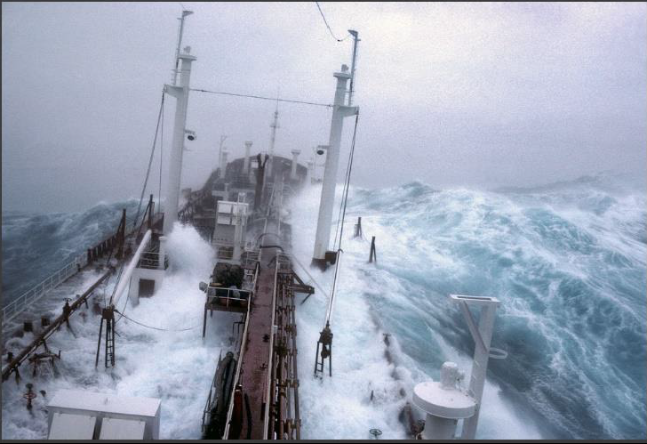
Green water

Slide 24
Green water
The pitching motion in rough and heading seas can produce the submersion of the bow main deck area. When the vessel emerges from the water can embark some part of water mass, called green water. In most green water incidents, the shipped water will not have any destabilizing effect.

Slide 25
Green water
However, in some cases until this water mass doesn’t return to the sea, it moves on the main deck uncontrolled producing the following undesirable effects: loss of operability, loss of stability, critic situation if this mass moves together with the roll motion, damage on the main deck equipment, structural problems, among others.

